Slide 1
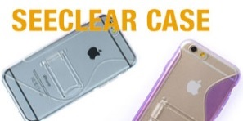

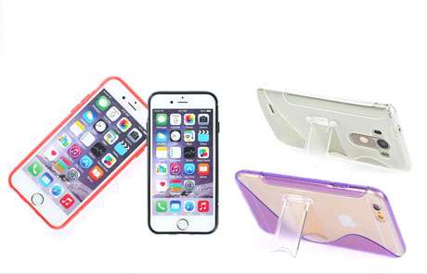
MOBILE ACCESSARY

Slide 2

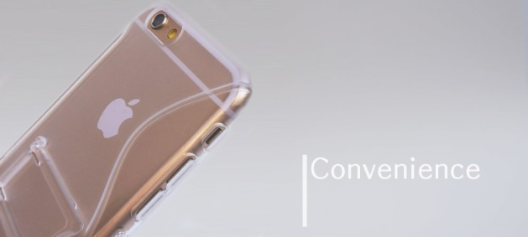

SEE CLEAR CLIP CASE
the Feel good SEECLEAR Case
Impact protection Jelly Case
the SEECLEAR case is smartphones
has a mount.
www.jpskorea.co.kr JPSkorea.Co.,Ltd.

Slide 3
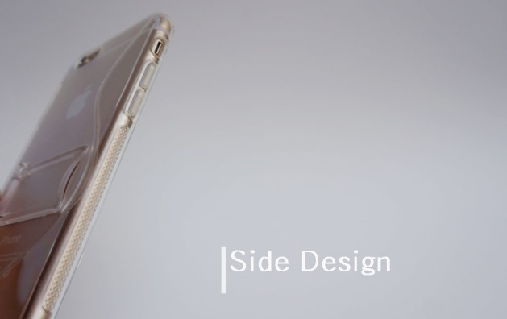
SEE CLEAR CLIP CASE
Anti-slip Case
Diamond pattern that implemented on both sides of the handle.
www.jpskorea.co.kr JPSkorea.Co.,Ltd.

Slide 4
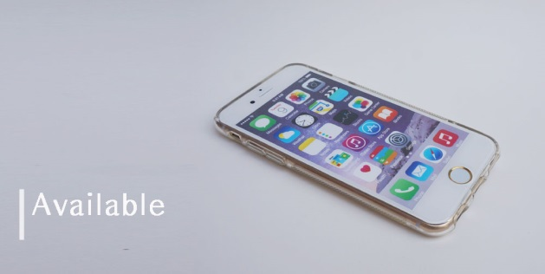
SEE CLEAR CLIP CASE
Applicable models : 10 models
LG G2, G3
iPhone5/5s, iPhone6, 6Plus
Galaxy S5, S6, Note 2, 3, 4
www.jpskorea.co.kr JPSkorea.Co.,Ltd.

Slide 5
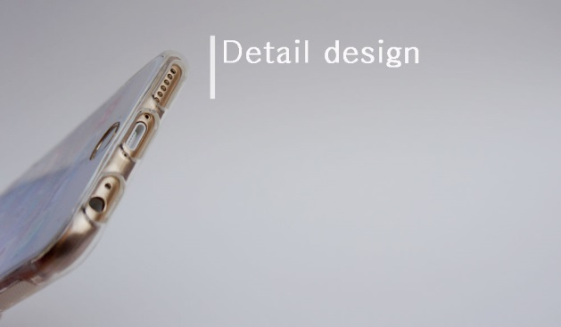
SEE CLEAR CLIP CASE
Delicate design, excellent touch button
Large hole
Delicate design, excellent touch button and you can use a variety of earphones and cable.
www.jpskorea.co.kr JPSkorea.Co.,Ltd.

Slide 6
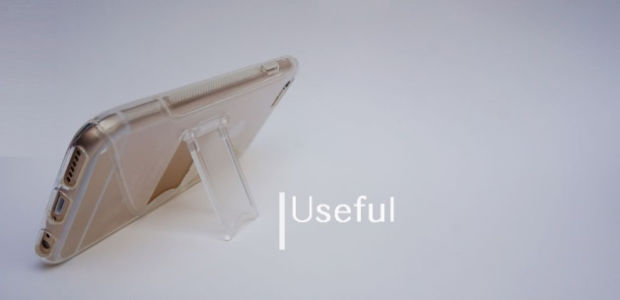
SEE CLEAR CLIP CASE
SEECLEAR Slim case can be mounted anywhere.
can be easily mounted anywhere.
Stay clear showing a smartphone design and slim design.
www.jpskorea.co.kr JPSkorea.Co.,Ltd.

Slide 7
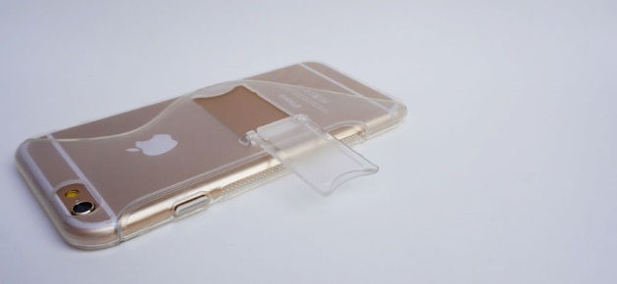
SEE CLEAR CLIP CASE
can't not damage in mount clip.
Special
No damage to shocks.
a replicated clip. if can’t not damage in mount clip.
www.jpskorea.co.kr JPSkorea.Co.,Ltd.

Slide 8
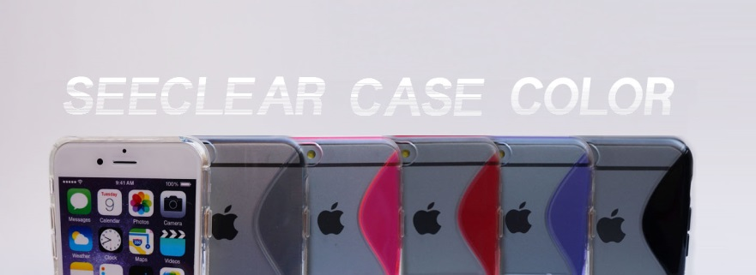
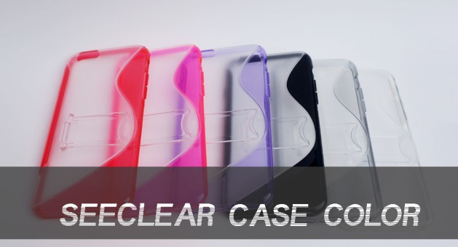
SEE CLEAR CLIP CASE
8 Pastel color
Pastel color : White / gray / pink / red / Purple / black / clear / blue
www.jpskorea.co.kr JPSkorea.Co.,Ltd.

Slide 9
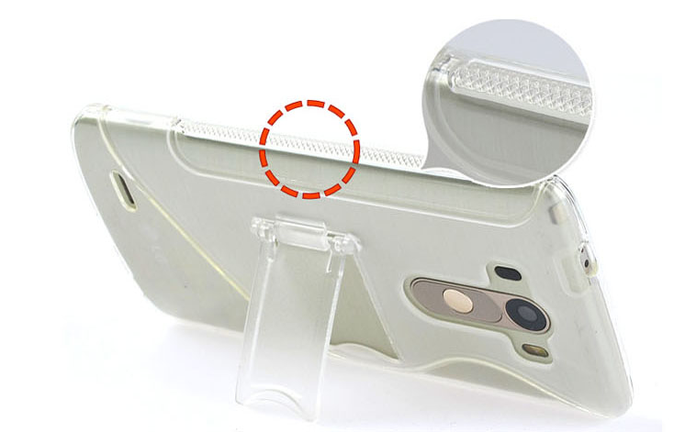
SEECLEAR CASE IMAGE.
www.jpskorea.co.kr JPSkorea.Co.,Ltd.

Slide 10
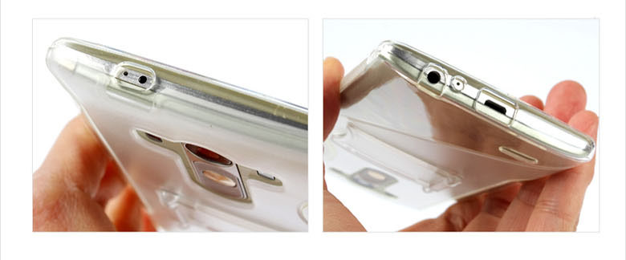
SEECLEAR CASE IMAGE.
www.jpskorea.co.kr JPSkorea.Co.,Ltd.

Slide 11
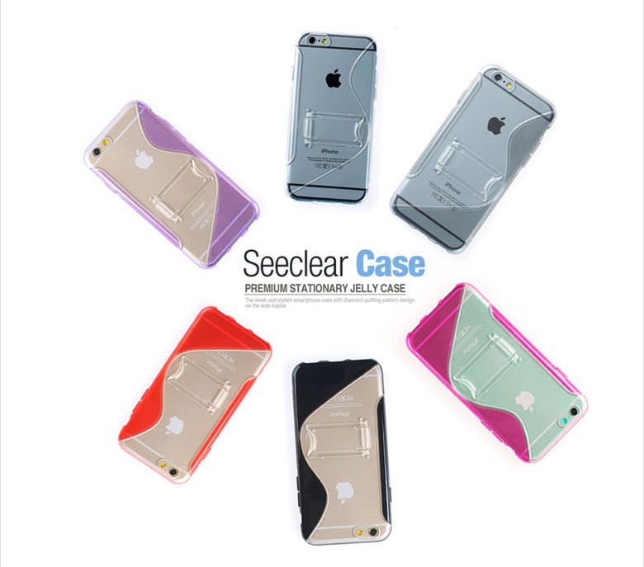
SEECLEAR CASE IMAGE.
www.jpskorea.co.kr JPSkorea.Co.,Ltd.

Slide 12
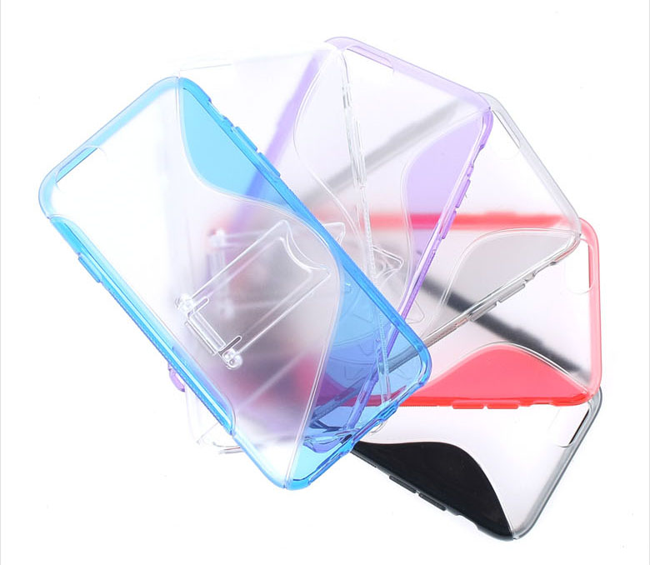
SEECLEAR CASE IMAGE.
www.jpskorea.co.kr JPSkorea.Co.,Ltd.

Slide 13
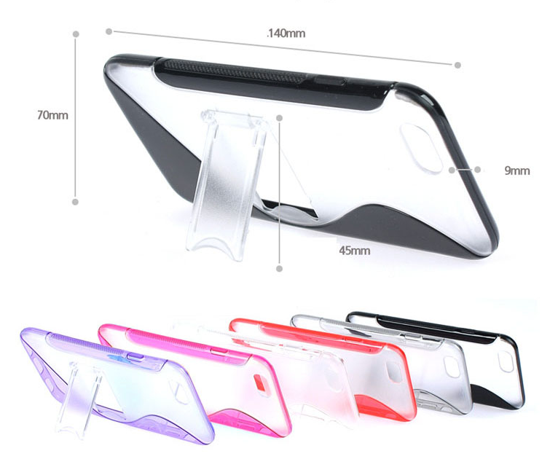
SEECLEAR CASE IMAGE.
www.jpskorea.co.kr JPSkorea.Co.,Ltd.

Slide 14
Thank you.

